Slide 1
AI-dle
Zach , Yasin, Seiya

Slide 2
What is our Project?
AI-dle is a simple game that integrates AI, styled in the format of a daily game
  EX: Wordle, Connections, Scrandle, and many others
How our game works:
  The player is given a prompt, which is chosen from a list of random prompts
  The player is given an AI response to the same prompt
  The player must guess which AI, out of a dropdown list of options, generated the response

Slide 3
OpenRouter
OpenRouter is the primary API tool we used
This tool routes prompts from the user to one of many different AI Models1,024 × 8031,024 × 803
We chose this tool because of it’s offered free models
Other Tools: Google AI Studio
  We created a free tier account and placed our API key in OpenRouter to route the prompt to our own account for higher availability

Slide 4
Models used
Gemma 4 - By google
Lfm-2.5-2.6b - By Liquid
nemotron 3.5 - By Nvidia
Dota 3- By Dots Studio

Slide 5
Program Flow
final_screen.py
-------------
Final screen, shows user the result of their guess. Additionally contains a button that loops back to the game screen
game_screen.py
-------------
The screen where the actual game takes place, this is where the user is presented with information from the API Script, and where the user submits their guess
app.py
-------------
Creates and opens the other screens used for the game
driver.py
-------------
Starting point for the program
API_Interaction.py
-------------
This is where API calls are made. Model and a prompt are submitted, and a string response is returned

Slide 6
Where could we go next?
UI:
  Add loading screens to make API waits less jarring
  Add effects or colors to react to user action
    ie: screen tints green or has an effect play on a correct guess
Program:
  Add more fallbacks in the event of an unavailable provider or rate limit
  Add more models
Game Design
  Have multiple chances, with added context with each
    Start with only response, then prompt, and then allow user to submit their own prompt

Slide 7
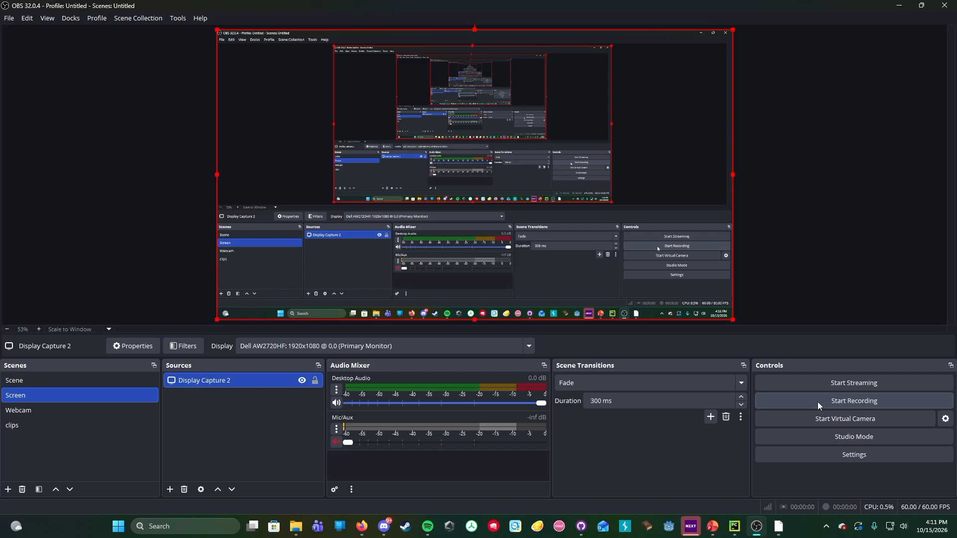
Program Demonstration

